Slide 1

18CSC302J- Computer Networks
Unit-5
School of Computing - SRMIST Kattankulathur Campus

Slide 2
CN – Unit – V
DSL
Other DSL Technology
DSL Benefits
Cable Technology
Compare DSL Vs Cable
Frame Relay, VPN
ATM Introduction
ATM Cell Format
ATM Layer
AAL Layer
ATM Application
PPP
PPP Services, Components
PPP frame and byte stuffing
HDLC
HDLC Transfer Modes, Frame
Types of HDLC Frame
MPLS - Multi-Protocol Label Switching
Contents:
18CSC302J- School of Computing (Odd sem 2020)

Slide 3
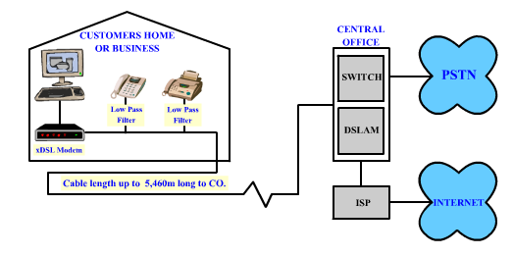
DSL (Digital subscriber line) Technology
Limited distance to central office (CO)
Dedicated line from CO to home
Asymmetric flow
Typical speeds up to 1.5Mbits/s downstream
18CSC302J- School of Computing (Odd sem 2020)

Slide 4
Digital Subscriber Line (DSL)
Uses a newer technology that used the existing telecommunications networks such as the local loop telephone line.
Is an asymmetric communication technology designed for residential users; it is not suitable for business.
xDSL: where x can be replaced by A, V, H, or S
The existing local loops can handle bandwidths up to 1.1 MHz
by removing the filter at the end of line of telephone company
but, limitation because of distance between the residence and the switching office, size of cable
ADSL is an adaptive technology. The system uses a data rate based on the condition of the local loop line

Slide 5
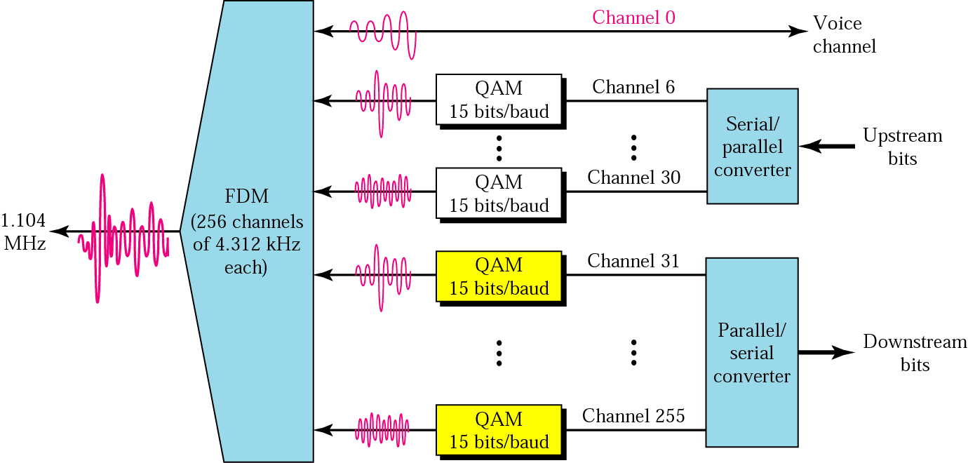
DMT
Modulation technique that has become standard for ADSL is called the Discrete Multi tone Technique (DMT)
QAM-quadrature amplitude modulation

Slide 6
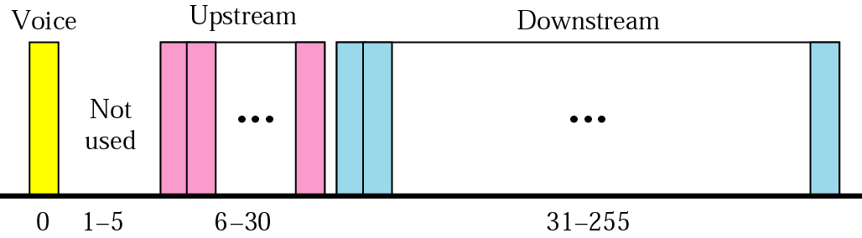
voice : channel 0 is reserved for voice
Idle : channel 1 to 5 are not used; gap between voice and data communicaiton
Upstream data and control : channels 6 to 30 (25channels); one channel for control
Downstream data and control : channels 31 to 255(225 channels); 13.4 Mbps; one channel for control
Source: Douglas E. Comer, Internetworking with TCP/IP, Principles, protocols, and architecture,Vol 1 5th Edition,2006
18CSC302J- School of Computing (Odd sem 2020)

Slide 7
Actual Bit Rate
Upstream : 64 Kbps to 1 Mbps
Downstream : 500 Kbps to 8 Mbps
* Because of the high signal/noise ratio
18CSC302J- School of Computing (Odd sem 2020)

Slide 8
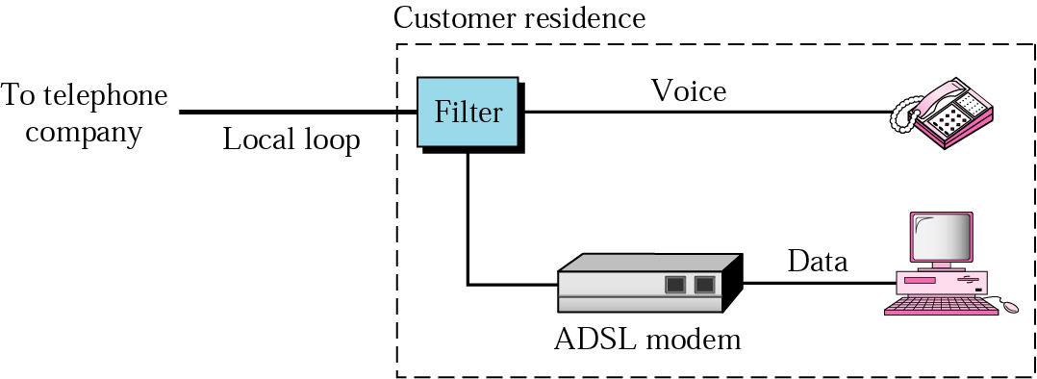
Customer Site : ADSL Modem
18CSC302J- School of Computing (Odd sem 2020)

Slide 9
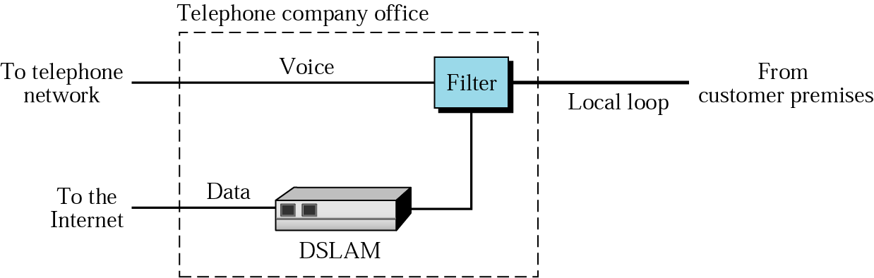
Telephone Company Site : DSLAM - Digital Subscriber Line Access Multiplexer

Slide 10
Other DSL Technologies
SDSL: Symmetric Digital Subscriber Line
HDSL: High-bit-rate digital subscriber line
an alternative to the T-line (1.544 Mbps)
using 2B1Q encoding
up to 3.6 Km
using 2 twisted-pair wires for full-duplex transmission
VDSL : Very-high-rate Digital Subscriber Line
using coaxial cable, fiber-optic, or twisted pair cable for short distances (300 to 1800 m)
using DMT with a bit rate of 50 to 55 Mbps downstream and 1.5 to 2.5 Mbps upstream

Slide 11
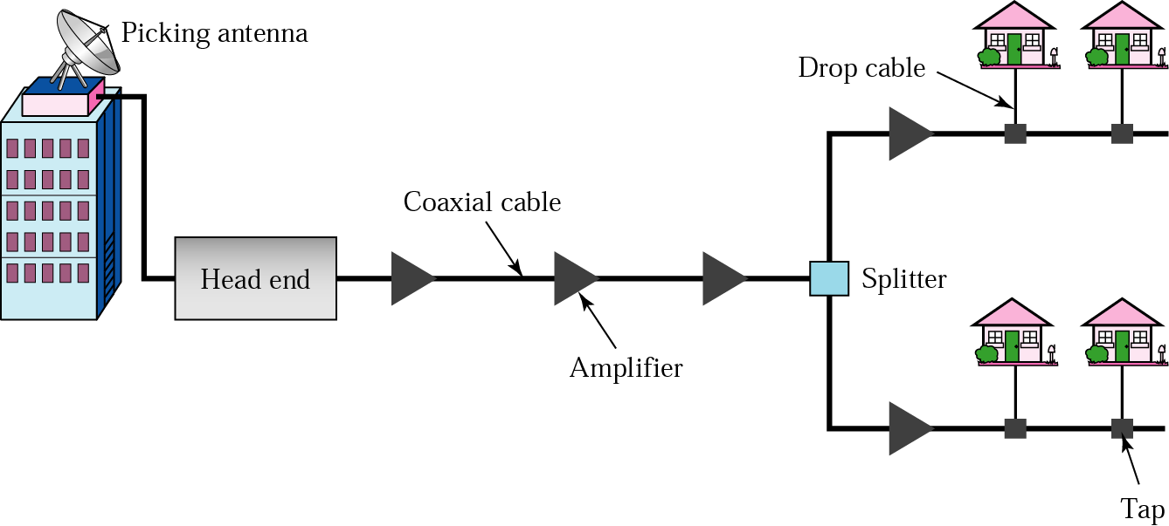
Communication in the traditional cable TV network is unidirectional.
Traditional cable Networks
community antenna TV (CATV)

Slide 12
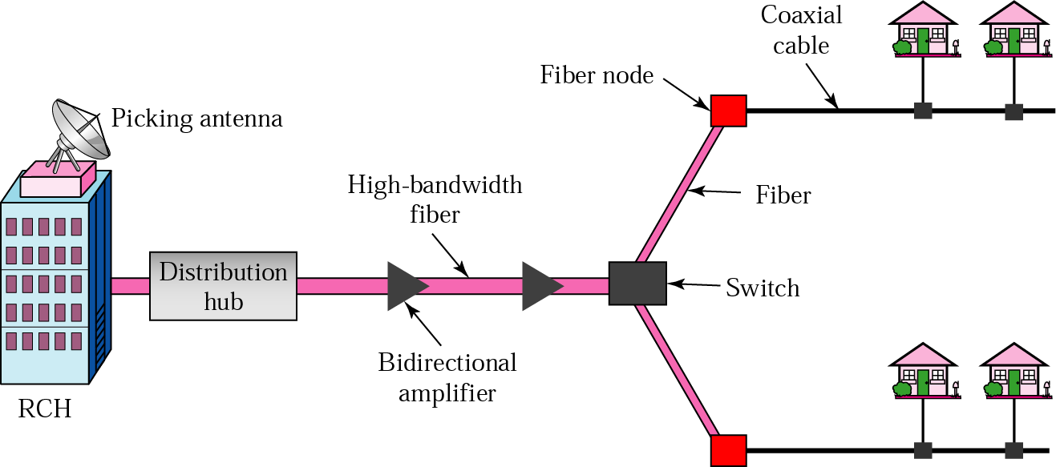
HFC (Hybrid fiber coaxial )Network
RCH : Regional cable head; serving 400,000 subscribers;
Distribution hub: serving 40,000 subscribers
Coaxial cable : serving 1,000 subscribers
Communication in HFC cable TV network can be bi direactional.

Slide 13
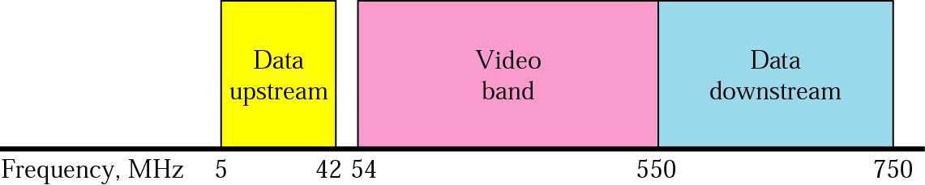
Bandwidth
video band
54 to 550 MHz
TV channels : 6 Mhz x 80 channels
Data downstream band : dividing into 6Mhz channels

Slide 14
Modulation
Downstream data are modulated using 64-QAM
Data rate
6 bits for each baud in 64-QAM (1bit : control bit)
Theoretically, 5bits/Hz x 6 Mhz = 30 Mbps
Upstream data band
Modulation
upstream data band uses lower frequencies that are more susceptible to noise and interference
for this reason, using QPSK instead of QAM
Data rate : 2 bits/hz x 6 Mhz = 12 Mbps

Slide 15
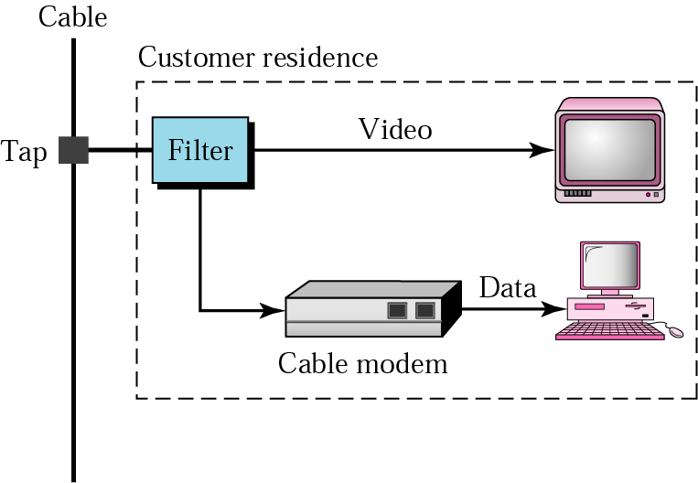
CM is installed inside the distribution hub by the cable company.

Slide 16
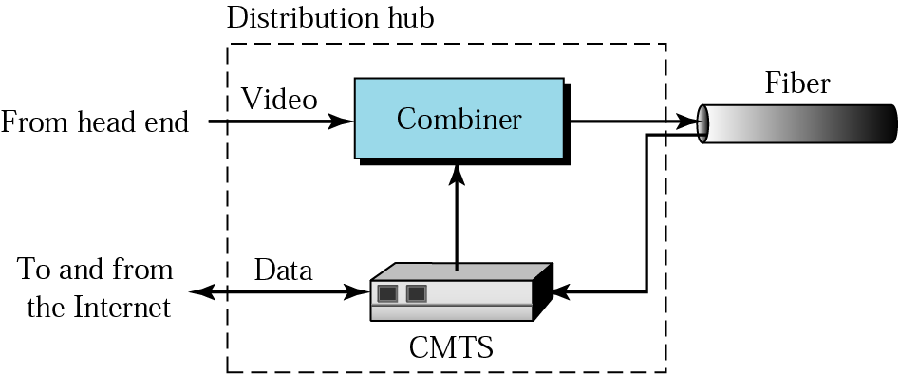
Cable modem transmission system(CMTS)

Slide 17
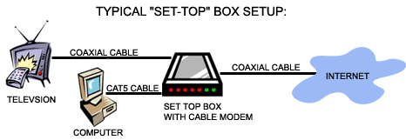
Shared lines to the nearest splitter
Generally higher speeds
Reaches more households since distance limitation is removed
Typical offering 4Mbits/s
Last Mile advantage
Notes:
The important points:
Shared lines means that quality can be bad at peak hours when everybody is on
Don’t have to be a certain distance from the exchange

Slide 18
Future Technology
WiMax
Metropolitan Area Networks (MANs)
3-5 miles range, no direct line of sight required
2Mbits/s practical limit
Can use existing cell towers
Broadband over Power Lines (BPL)
More pervasive infrastructure, but requires extra equipment
Up to 2.7Mbits/s
Superimposing analog signal over AC
Small deployments in operation (e.g. Manassas, Virginia 10MBits/s for $30.00 a month)

Slide 19
Frame Relay

Slide 20
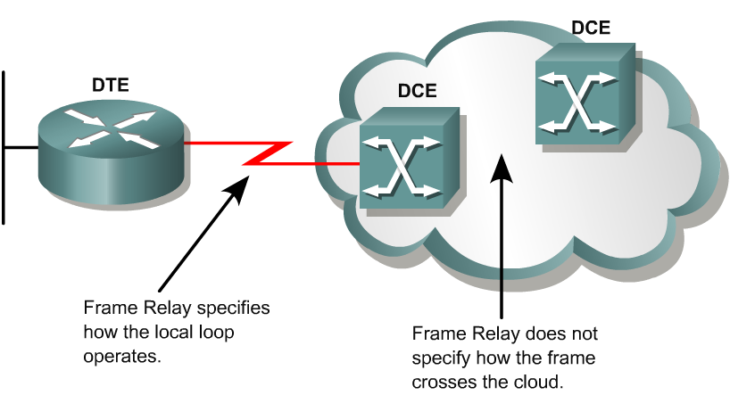
Introducing Frame Relay
Frame Relay is a packet-switched, connection-oriented, WAN service.
It operates at the data link layer of the OSI reference model.
Frame Relay uses a subset of the high-level data link control (HDLC) protocol called Link Access Procedure for Frame Relay (LAPF).
Frames carry data between user devices called data terminal equipment (DTE), and the data communications equipment (DCE) at the edge of the WAN.

Slide 21
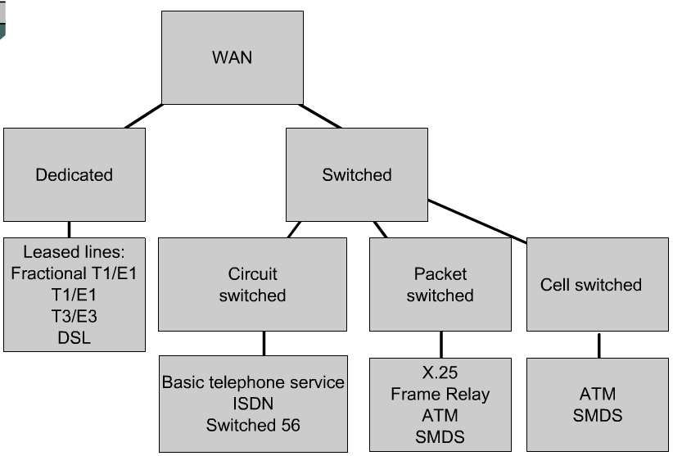
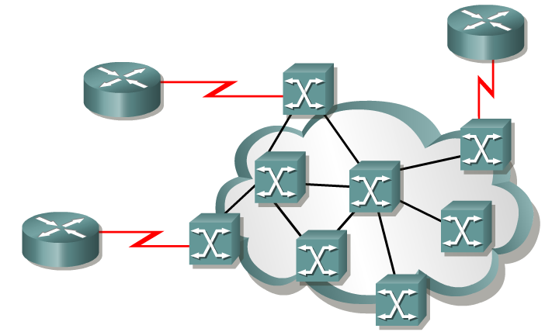
Frame Relay vs. X.25
Frame Relay does not have the sequencing, windowing, and retransmission mechanisms that are used by X.25.
Without the overhead, the streamlined operation of Frame Relay outperforms X.25.
Typical speeds range from 1.5 Mbps to 12 Mbps, although higher speeds are possible. (Up to 45 Mbps)
The network providing the Frame Relay service can be either a carrier-provided public network or a privately owned network.
Because it was designed to operate on high-quality digital lines, Frame Relay provides no error recovery mechanism.
If there is an error in a frame it is discarded without notification.

Slide 22
Introducing Frame Relay
Access circuits
A Frame Relay network may be privately owned, but it is more commonly provided as a service by a public carrier.
It typically consists of many geographically scattered Frame Relay switches interconnected by trunk lines.
Frame Relay is often used to interconnect LANs. When this is the case, a router on each LAN will be the DTE.
Access Circuit - A serial connection, such as a T1/E1 leased line, will connect the router to a Frame Relay switch of the carrier at the nearest point-of-presence for the carrier.

Slide 23
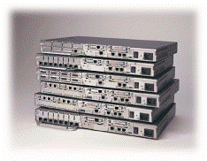
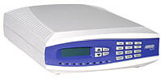
DTE – Data Terminal Equipment
DTEs generally are considered to be terminating equipment for a specific network and typically are located on the premises of the customer.
The customer may also own this equipment.
Examples of DTE devices are routers and Frame Relay Access Devices (FRADs).
A FRAD is a specialized device designed to provide a connection between a LAN and a Frame Relay WAN.

Slide 24
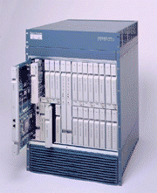
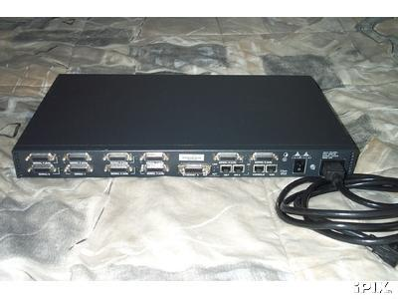
DCE – Data Communications Equipment
UNI
NNI
DCEs are carrier-owned internetworking devices.
The purpose of DCE equipment is to provide clocking and switching services in a network.
In most cases, these are packet switches, which are the devices that actually transmit data through the WAN.
The connection between the customer and the service provider is known as the User-to-Network Interface (UNI).
The Network-to-Network Interface (NNI) is used to describe how Frame Relay networks from different providers connect to each other.

Slide 25
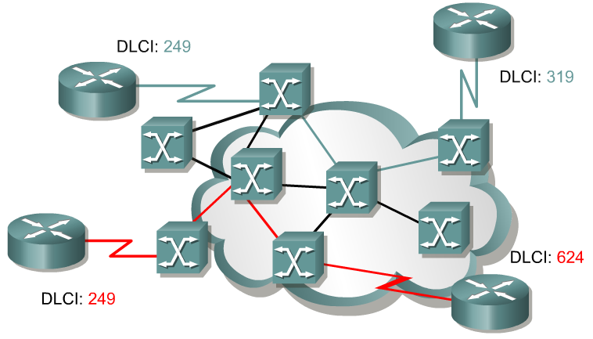
Frame Relay terminology
An SVC between the same two DTEs may change.
A PVC between the same two DTEs will always be the same.
Path may change.
Always same Path.
The connection through the Frame Relay network between two DTEs is called a virtual circuit (VC).
Switched Virtual Circuits (SVCs) are Virtual circuits may be established dynamically by sending signaling messages to the network.
However, SVCs are not very common.
Permanent Virtual Circuits (PVCs) are more common.
PVC are VCs that have been preconfigured by the carrier are used.
The switching information for a VC is stored in the memory of the switch.

Slide 26
Frame Relay operation - SVC
An SVC between the same two DTEs may change.
A PVC between the same two DTEs will always be the same.
Path may change.
Always same Path.
SVCs are temporary connections that are only used when there is sporadic data transfer between DTE devices across the Frame Relay network.
Because they are temporary, SVC connections require call setup and termination for each connection supported by Cisco IOS Release 11.2 or later.
Before implementing these temporary connections, determine whether the service carrier supports SVCs since many Frame Relay providers only support PVCs.

Slide 27
Access Circuits and Cost Savings
The FRAD or router connected to the Frame Relay network may have multiple virtual circuits connecting it to various end points.
This makes it a very cost-effective replacement for a full mesh of access lines.
Each end point needs only a single access circuit and interface.

Slide 28
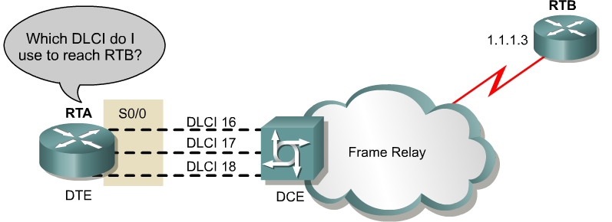
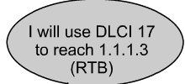
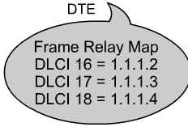
DLCI
A data-link connection identifier (DLCI) identifies the logical VC between the CPE and the Frame Relay switch.
The Frame Relay switch maps the DLCIs between each pair of routers to create a PVC.
DLCIs have local significance, although there some implementations that use global DLCIs.
DLCIs 0 to 15 and 1008 to 1023 are reserved for special purposes.
Service providers assign DLCIs in the range of 16 to 1007.
DLCI 1019, 1020: Multicasts
DLCI 1023: Cisco LMI
DLCI 0: ANSI LMI

Slide 29
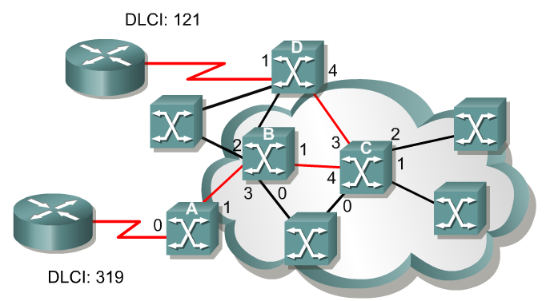

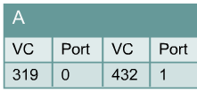


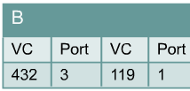

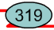
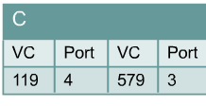
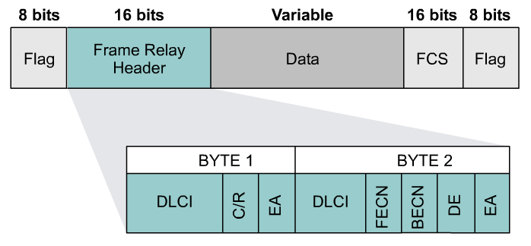
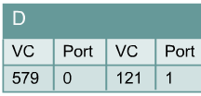
DLCI
Inside the cloud, your Frame Relay provider sets up the DLCI numbers to be used by the routers for establishing PVCs.

Slide 30
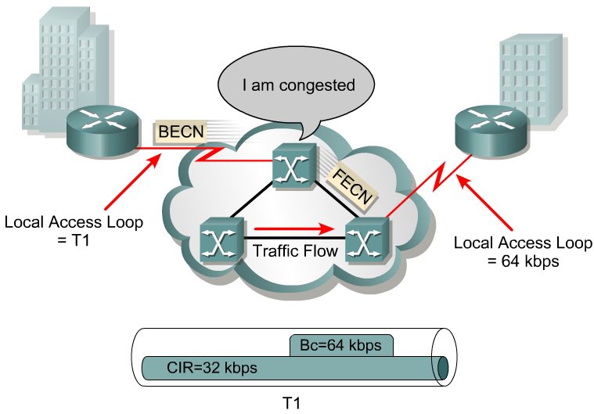
Frame Relay bandwidth and flow control
The first thing we need to do is become familiar with some of the terminology.
Local access rate – This is the clock speed or port speed of the connection or local loop to the Frame Relay cloud.
It is the rate at which data travels into or out of the network, regardless of other settings.
Committed Information Rate (CIR) – This is the rate, in bits per second, at which the Frame Relay switch agrees to transfer data.
The rate is usually averaged over a period of time, referred to as the committed rate measurement interval (Tc).
In general, the duration of Tc is proportional to the "burstiness" of the traffic.

Slide 31
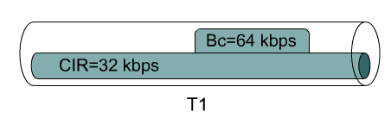
Frame Relay bandwidth and flow control
Tc = 2 seconds Bc = 64 kbps CIR = 32 kbps
Committed burst (Bc) – The maximum number of bits that the switch agrees to transfer during any Tc.
The higher the Bc-to-CIR ratio, the longer the switch can handle a sustained burst.
The DE (Discard Eligibility) bit is set on the traffic that was received after the CIR was met. (coming)
(FYI) For example, if the Tc is 2 seconds and the CIR is 32 kbps, the Bc is 64 kbps.
(FYI) The Tc calculation is Tc = Bc/CIR.
Committed Time Interval (Tc) – Tc is not a recurrent time interval. It is used strictly to measure inbound data, during which time it acts like a sliding window. Inbound data triggers the Tc interval.

Slide 32
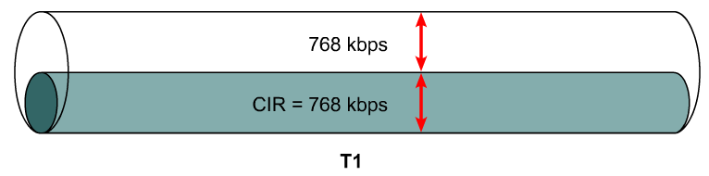
Frame Relay bandwidth and flow control
Be = 772 kbps
Bc = 128 kbps Tc = Bc/CIR
EIR = 1544 Mbps
CIR = 772 kbps
Excess burst (Be) – This is the maximum number of uncommitted bits that the Frame Relay switch attempts to transfer beyond the CIR.
Excessive Burst (Be) is dependent on the service offerings available from your vendor, but it is typically limited to the port speed of the local access loop.
Excess Information Rate (EIR) – This defines the maximum bandwidth available to the customer, which is the CIR plus the Be.
Typically, the EIR is set to the local access rate.
In the event the provider sets the EIR to be lower than the local access rate, all frames beyond that maximum can be discarded automatically, even if there is no congestion.

Slide 33
Frame Relay bandwidth and flow control

Slide 34
Forward Explicit Congestion Notification (FECN) – When a Frame Relay switch recognizes congestion in the network, it sends an FECN packet to the destination device.
This indicates that congestion has occurred.
Backward Explicit Congestion Notification (BECN) – When a Frame Relay switch recognizes congestion in the network, it sends a BECN packet to the source router.
This instructs the router to reduce the rate at which it is sending packets.
With Cisco IOS Release 11.2 or later, Cisco routers can respond to BECN notifications.

Slide 35
Frame Relay bandwidth and flow control
Discard eligibility (DE) bit – When the router or switch detects network congestion, it can mark the packet "Discard Eligible".
The DE bit is set on the traffic that was received after the CIR was met.
These packets are normally delivered.
However, in periods of congestion, the Frame Relay switch will drop packets with the DE bit set first.

Slide 36
Frame Relay bandwidth
Several factors determine the rate at which a customer can send data on a Frame Relay network.
Foremost in limiting the maximum transmission rate is the capacity of the local loop to the provider.
If the local loop is a T1, no more than 1.544 Mbps can be sent.
In Frame Relay terminology, the speed of the local loop is called the local access rate.
Providers use the CIR parameter to provision network resources and regulate usage.
For example, a company with a T1 connection to the packet-switched network (PSN) may agree to a CIR of 768 Kbps.
This means that the provider guarantees 768 Kbps of bandwidth to the customer’s link at all times.

Slide 37
Frame Relay bandwidth
Typically, the higher the CIR, the higher the cost of service.
Customers can choose the CIR that is most appropriate to their bandwidth needs, as long as the CIR is less than or equal to the local access rate.
If the CIR of the customer is less than the local access rate, the customer and provider agree on whether bursting above the CIR is allowed.
If the local access rate is T1 or 1.544 Mbps, and the CIR is 768 Kbps, half of the potential bandwidth (as determined by the local access rate) remains available.

Slide 38
Frame Relay bandwidth
Many providers allow their customers to purchase a CIR of 0 (zero).
This means that the provider does not guarantee any throughput.
In practice, customers usually find that their provider allows them to burst over the 0 (zero) CIR virtually all of the time.
If a CIR of 0 (zero) is purchased, carefully monitor performance in order to determine whether or not it is acceptable.
Frame Relay allows a customer and provider to agree that under certain circumstances, the customer can “burst” over the CIR.
Since burst traffic is in excess of the CIR, the provider does not guarantee that it will deliver the frames.

Slide 39
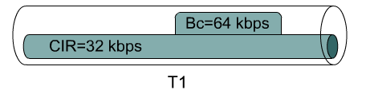
Frame Relay bandwidth
Either a router or a Frame Relay switch tags each frame that is transmitted beyond the CIR as eligible to be discarded.
When a frame is tagged DE, a single bit in the Frame Relay frame is set to 1.
This bit is known as the discard eligible (DE) bit.
The Frame Relay specification also includes a protocol for congestion notification.
This mechanism relies on the FECN/ BECN bits in the Q.922 header of the frame.
The provider’s switches or the customer’s routers can selectively set the DE bit in frames.
These frames will be the first to be dropped when congestion occurs.

Slide 40
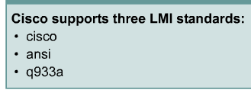
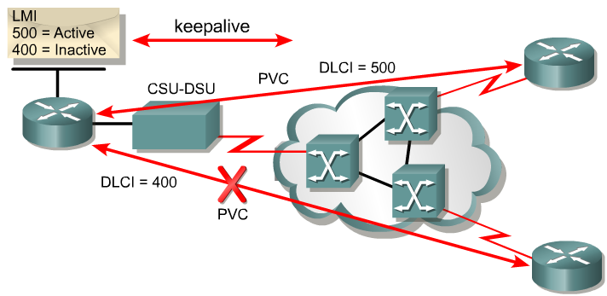
LMI – Local Management Interface
LMI is a signaling standard between
the DTE and the Frame Relay switch.
LMI is responsible for managing the connection and maintaining
the status between devices.
LMI includes:
A keepalive mechanism, which verifies that data is flowing
A multicast mechanism, which provides the network server (router) with its local DLCI.
The multicast addressing, which can give DLCIs global rather than local significance in Frame Relay networks (not common).
A status mechanism, which provides an ongoing status on the DLCIs known to the switch

Slide 41
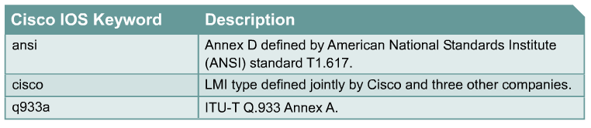
LMI
LMI
In order to deliver the first LMI services to customers as soon as possible, vendors and standards committees worked separately to develop and deploy LMI in early Frame Relay implementations.
The result is that there are three types of LMI, none of which is compatible with the others.
Cisco, StrataCom, Northern Telecom, and Digital Equipment Corporation (Gang of Four) released one type of LMI, while the ANSI and the ITU-T each released their own versions.
The LMI type must match between the provider Frame Relay switch and the customer DTE device.

Slide 42
LMI
LMI
In Cisco IOS releases prior to 11.2, the Frame Relay interface must be manually configured to use the correct LMI type, which is furnished by the service provider.
If using Cisco IOS Release 11.2 or later, the router attempts to automatically detect the type of LMI used by the provider switch.
This automatic detection process is called LMI autosensing.
No matter which LMI type is used, when LMI autosense is active, it sends out a full status request to the provider switch.

Slide 43
LMI
The Frame Relay switch uses LMI to report the status of configured PVCs.
The three possible PVC states are as follows:
Active state – Indicates that the connection is active and that routers can exchange data.
Inactive state – Indicates that the local connection to the Frame Relay switch is working, but the remote router connection to the Frame Relay switch is not working.
Deleted state – Indicates that no LMI is being received from the Frame Relay switch, or that there is no service between the CPE router and Frame Relay switch.

Slide 44
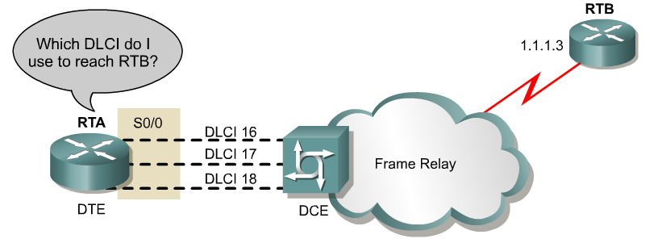
DLCI Mapping to Network Address
Manual
Manual: Administrators use a frame relay map statement.
Dynamic
Inverse Address Resolution Protocol (I-ARP) provides a given DLCI and requests next-hop protocol addresses for a specific connection.
The router then updates its mapping table and uses the information in the table to forward packets on the correct route.

Slide 45
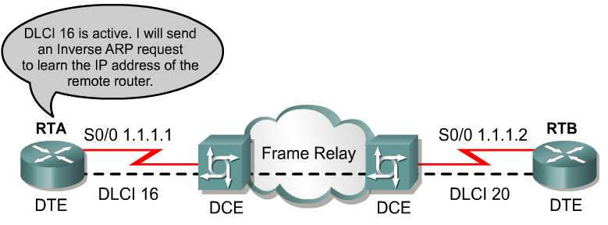
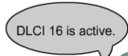
Inverse ARP – Knows DLCI, needs remote IP
2
1
3
My DLCI 16 Your IP? My IP is 1.1.1.1
4
My IP is 1.1.1.2
Once the router learns from the switch about available PVCs and their corresponding DLCIs, the router can send an Inverse ARP request to the other end of the PVC. (unless statically mapped – later)
For each supported and configured protocol on the interface, the router sends an Inverse ARP request for each DLCI. (unless statically mapped)
In effect, the Inverse ARP request asks the remote station for its Layer 3 address.
At the same time, it provides the remote system with the Layer 3 address of the local system.
The return information from the Inverse ARP is then used to build the Frame Relay map.

Slide 46
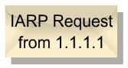
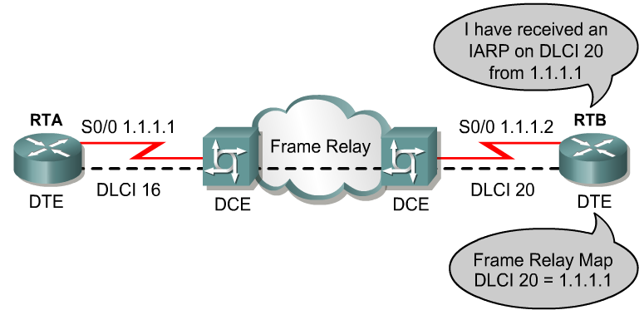
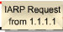
Inverse ARP – Knows DLCI, needs remote IP
Inverse Address Resolution Protocol (Inverse ARP) was developed to provide a mechanism for dynamic DLCI to Layer 3 address maps.
Inverse ARP works much the same way Address Resolution Protocol (ARP) works on a LAN.
However, with ARP, the device knows the Layer 3 IP address and needs to know the remote data link MAC address.
With Inverse ARP, the router knows the Layer 2 address which is the DLCI, but needs to know the remote Layer 3 IP address.

Slide 47
Configuring Frame Relay maps
Router(config-if)#frame-relay map protocol protocol-address dlci [broadcast] [ietf | cisco]
If the environment does not support LMI autosensing and Inverse ARP, a Frame Relay map must be manually configured.
Use the frame-relay map command to configure static address mapping.
Once a static map for a given DLCI is configured, Inverse ARP is disabled on that DLCI.
The broadcast keyword is commonly used with the frame-relay map command.
The broadcast keyword:
Forwards broadcasts when multicasting is not enabled.

Slide 48
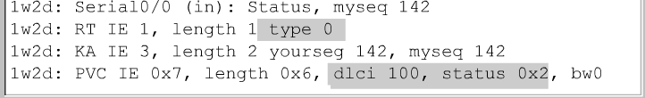
debug frame-relay lmi (continued)
FYI ONLY
The possible values of the status field are as follows:
0x0 – Added/inactive means that the switch has this DLCI programmed but for some reason it is not usable. The reason could possibly be the other end of the PVC is down.
0x2 – Added/active means the Frame Relay switch has the DLCI and everything is operational.
0x4 – Deleted means that the Frame Relay switch does not have this DLCI programmed for the router, but that it was programmed at some point in the past. This could also be caused by the DLCIs being reversed on the router, or by the PVC being deleted by the service provider in the Frame Relay cloud.

Slide 49
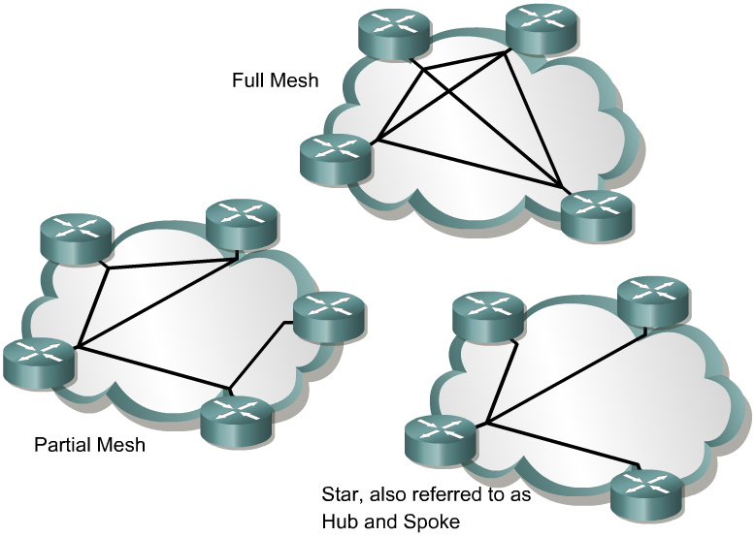
Frame Relay Topologies

Slide 50
NBMA – Non Broadcast Multiple Access
Frames between two routers are only seen by those two devices (non broadcast). Similar to a LAN, multiple computers have access to the same network and potentially to each other (multiple access).
An NBMA network is the opposite of a broadcast network.
On a broadcast network, multiple computers and devices are attached to a shared network cable or other medium. When one computer transmits frames, all nodes on the network "listen" to the frames, but only the node to which the frames are addressed actually receives the frames. Thus, the frames are broadcast.
A nonbroadcast multiple access network is a network to which multiple computers and devices are attached, but data is transmitted directly from one computer to another over a virtual circuit or across a switching fabric. The most common examples of nonbroadcast network media include ATM (Asynchronous Transfer Mode), frame relay, and X.25.
http://www.linktionary.com/

Slide 51
Star Topology
A star topology, also known as a hub and spoke configuration, is the most popular Frame Relay network topology because it is the most cost-effective.
In this topology, remote sites are connected to a central site that generally provides a service or application.
This is the least expensive topology because it requires the fewest PVCs.
In this example, the central router provides a multipoint connection, because it is typically using a single interface to interconnect multiple PVCs.

Slide 52
Full Mesh
Full Mesh Topology
Number of Number of
Connections PVCs
----------------- --------------
2 1
4 6
6 15
8 28
10 45
In a full mesh topology, all routers have PVCs to all other destinations.
This method, although more costly than hub and spoke, provides direct connections from each site to all other sites and allows for redundancy.
For example, when one link goes down, a router at site A can reroute traffic through site C.
As the number of nodes in the full mesh topology increases, the topology becomes increasingly more expensive.
The formula to calculate the total number of PVCs with a fully meshed WAN is [n(n - 1)]/2, where n is the number of nodes.

Slide 53
VPN (Virtual Private Network)

Slide 54
VPN (Virtual Private Network)
VPN is a network that is private but virtual.
It is private because it guarantees privacy inside the organization.
It is virtual because it does not use real private WANs; the network is physically public but virtually private.
Routers R1 and R2 use VPN technology to guarantee privacy for the organization.

Slide 55
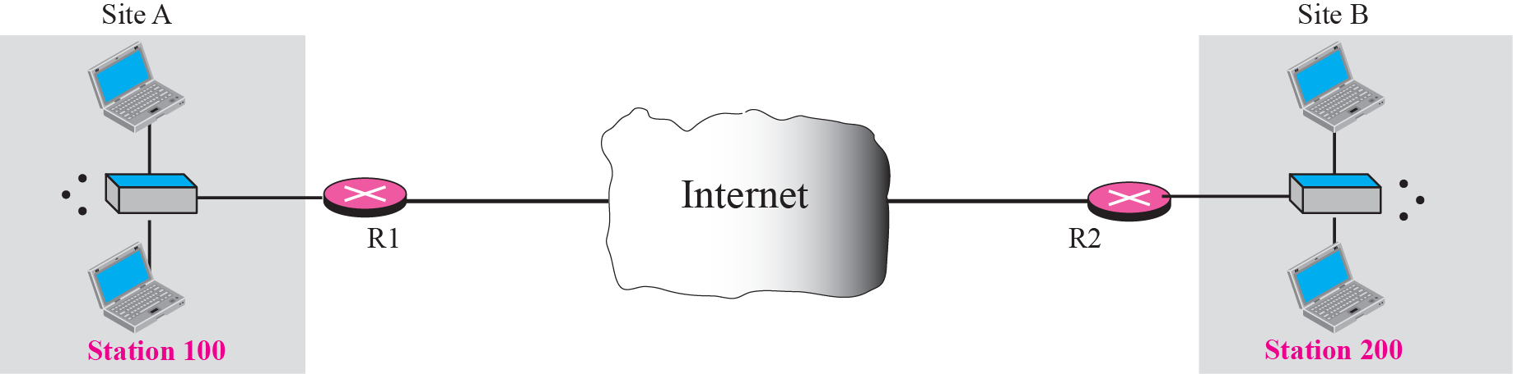
Virtual private network

Slide 56
TRANSPORT LAYER SECURITY
Two protocols are dominant today for providing security at the transport layer: the Secure Sockets Layer (SSL) protocol and the Transport Layer Security (TLS) protocol. The latter is actually an IETF version of the former. We discuss SSL in this section; TLS is very similar. Figure shows the position of SSL and TLS in the Internet model.

Slide 57
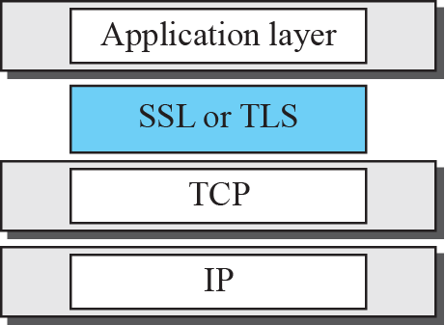
Location of SSL and TSL in the Internet mode

Slide 58
SSL services
SSL provides several services on data received from the application layer. ❑ Fragmentation. First, SSL divides the data into blocks of 214 bytes or less. ❑ Compression. Each fragment of data is compressed using one of the lossless compression methods negotiated between the client and server. This service is optional. ❑ Message Integrity. To preserve the integrity of data, SSL uses a keyed-hash function to create a MAC (see Chapter 29). ❑ Confidentiality. To provide confidentiality, the original data and the MAC are encrypted using symmetric-key cryptography. ❑ Framing. A header is added to the encrypted payload. The payload is then passed to a reliable transport layer protocol

Slide 59
Key Exchange Algorithms
To exchange an authenticated and confidential message, the client and the server each need a set of cryptographic secrets.
However, to create these secrets, one pre-master secret must be established between the two parties.
SSL defines several key-exchange methods to establish this pre-master secret.

Slide 60
Key Exchange Algorithms
Encryption/Decryption Algorithms The client and server also need to agree to a set of encryption and decryption algorithms. Hash Algorithms SSL uses hash algorithms to provide message integrity (message authentication). Several hash algorithms have also been defined for this purpose. Cipher Suite The combination of key exchange, hash, and encryption algorithms defines a cipher suite for each SSL session. Compression Algorithms Compression is optional in SSL. No specific compression algorithm is defined. Therefore a system can use whatever compression algorithm it desires.

Slide 61
Cryptographic Parameter Generation
To achieve message integrity and confidentiality, SSL needs six cryptographic secrets, four keys and two IVs (initialization vectors).
The client needs one key for message authentication, one key for encryption, and one IV as original block in calculation.
The server needs the same. SSL requires that the keys for one direction be different from those for the other direction.

Slide 62
Cryptographic Parameter Generation
1. The client and server exchange two random numbers; one is created by the client and the other by the server
2. The client and server exchange one pre-master secret using one of the predefined key- exchange algorithms. 3. A 48-byte master secret is created from the pre-master secret by applying two hash functions (SHA-1 and MD5)

Slide 63
Cryptographic Parameter Generation
4. The master secret is used to create variable-length key material by applying the same set of hash functions and prepending with different constants, as shown in Figure The module is repeated until key material of adequate size is created.
5. Six different secrets are extracted from the key material, as shown in Figure

Slide 64
Calculation of maser key from pre-master secret

Slide 65
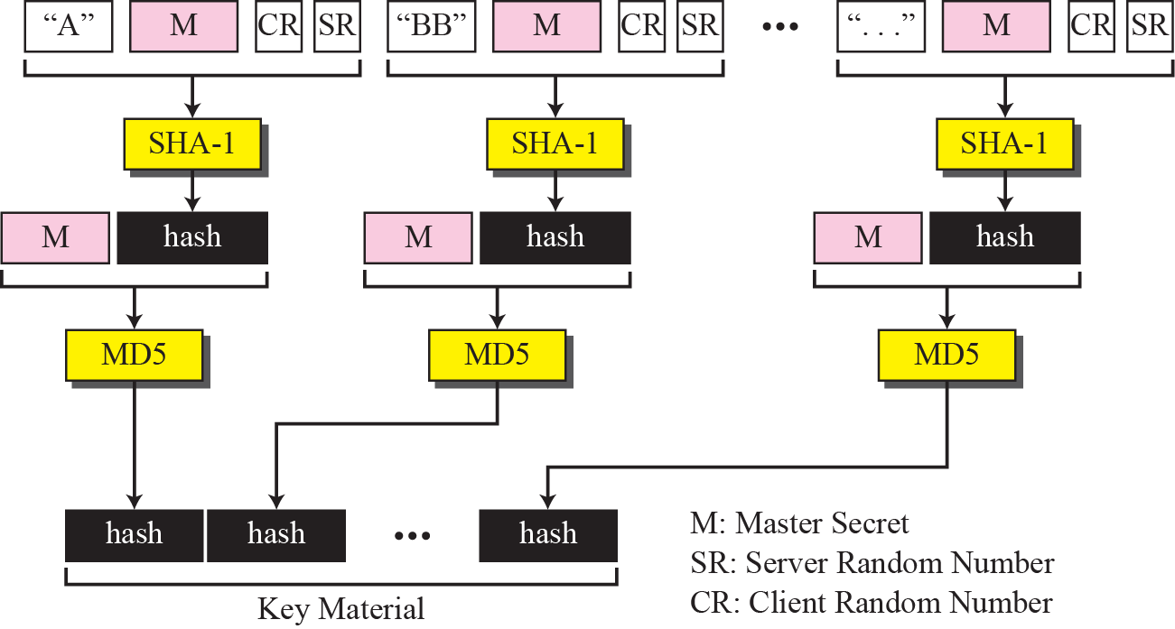
Calculation of the key materials from master secret

Slide 66
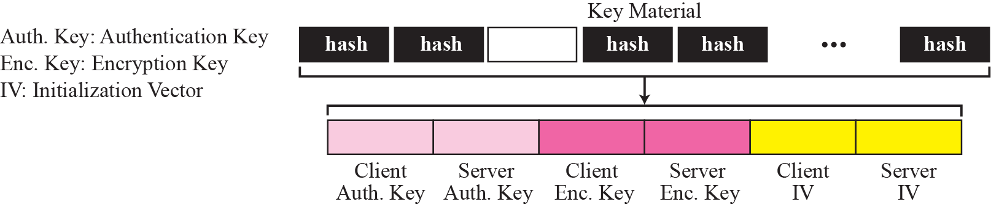
Extraction of cryptographic secrets from key materials

Slide 67
Sessions and Connections
A session is an association between a client and a server
A session can consist of many connections. A connection between two parties can be terminated and reestablished within the same session. A session can consist of many connections.
A connection between two parties can be terminated and reestablished within the same session.

Slide 68
Handshake Protocol
Handshake Protocol uses messages to negotiate the cipher suite, to authenticate the server to the client and the client to the server if needed, and to exchange information for building the cryptographic secrets.

Slide 69
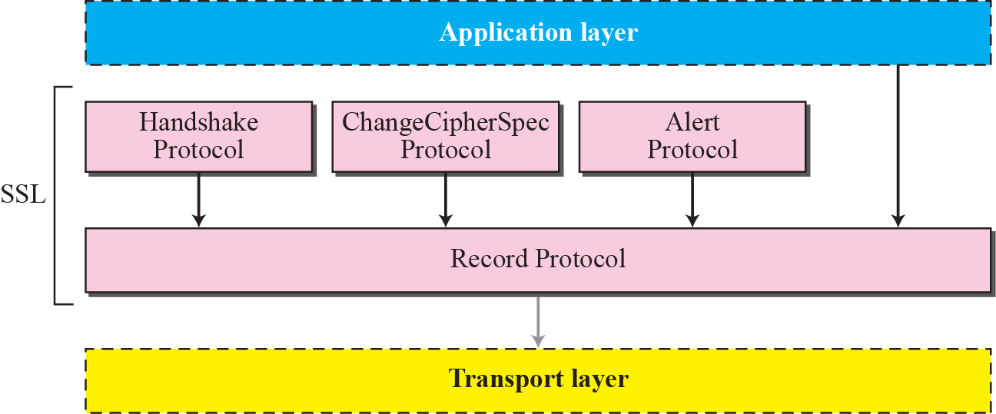
Four SSL protocols

Slide 70
Handshake protocol

Slide 71
Phase I: Establishing Security Capability
In Phase I, the client and the server announce their security capabilities and choose those that are convenient for both.
In this phase, a session ID is established and the cipher suite is chosen. The parties agree upon a particular compression method.
Finally, two random numbers are selected, one by the client and one by the server, to be used for creating a master secret as we saw before.

Slide 72

Note
After Phase I, the client and server know the version of SSL, the cryptographic algorithms, the compression method, and the two random numbers for key generation.

Slide 73
Phase II: Server Key Exchange and Authentication
In Phase II, the server authenticates itself if needed.
The sender may send its certificate, its public key, and may also request certificates from the client.

Slide 74
Note
After Phase II, the server is authenticated to the client, and the client knows the public
key of the server if required.

Slide 75
Phase III is designed to authenticate the client.
Phase III is designed to authenticate the client.

Slide 76
Note
After Phase III, The client is authenticated for the serve, and both the client and the server know the pre-master secret.

Slide 77
Phase IV: Finalizing and Finishing
In Phase IV, the client and server send messages to change cipher specification and to finish the handshaking protocol

Slide 78
Record Protocol
The Record Protocol carries messages from the upper layer (Handshake Protocol,ChangeCipherSpec Protocol, Alert Protocol, or application layer).
The message is fragmented and optionally compressed; a MAC is added to the compressed message using the negotiated hash algorithm.
The compressed fragment and the MAC are encrypted using the negotiated encryption algorithm.
Finally, the SSL header is added to the encrypted message. Figure shows this process at the sender. The process at the receiver is reversed.

Slide 79
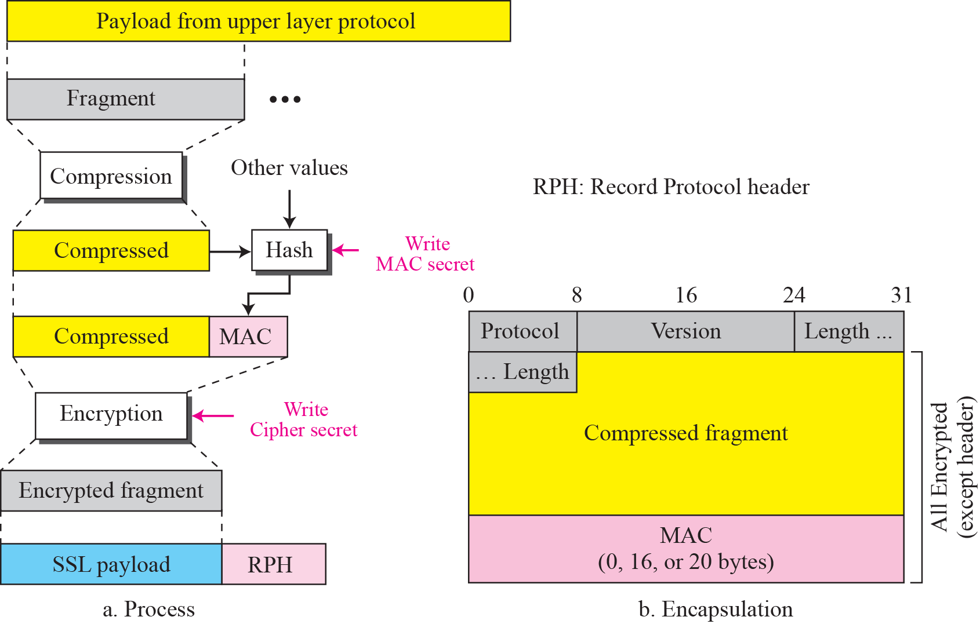
Processing done by the record protocol

Slide 80
Asynchronous Transfer Mode
ATM
School of Computing - SRMIST Kattankulathur Campus

Slide 81
ATM Features
Cell relay protocol.
Works along with SONET to provide high speed interconnection.
Designed by ATM Forum and adopted by ITU-T.

Slide 82
ATM
Destined to replace most existing WAN technologies
Improves on performance of Frame Relay
53-byte cells of fixed size=48 byte data+5 header
The standard-sized cells allow switching mechanisms to achieve faster switching rates
Rates of 155 – 622 Mbps are achieved with theoretical rates up to 1.2 Gbps
Compatible with twisted-pair, coax, and fiber
ATM uses Asynchronous Time Division Multiplexing
Allows any-speed and even variable rate connection

Slide 83
Issues Driving LAN Changes
Traffic Integration
Voice, video and data traffic
Multimedia became the ‘buzz word’
One-way batch Web traffic
Two-way batch voice messages
One-way interactive Mbone broadcasts
Two-way interactive video conferencing
Quality of Service guarantees (e.g. limited jitter, non-blocking streams)
LAN Interoperability
Mobile and Wireless nodes

Slide 84

ATM LAN
Source: William stallings, Data and computer communications, Eigth edition

Slide 85

ATM LAN Hub configuration
Source: William stallings, Data and computer communications, Eigth edition

Slide 86
Voice
ATM Adaptation Layers
A/D
AAL
s_{1 ,} s₂ …
cells
Digital voice samples
Video
A/D
…
Compression
AAL
cells
picture frames
compressed frames
Data
AAL
Bursty variable-length packets
cells
Source: Leon-Garcia & Widjaja: Communication Networks Copyright ©2000 The McGraw Hill Companies

Slide 87
Asynchronous Transfer Mode (ATM)
Voice
Data packets
MUX
Wasted bandwidth
Images
TDM
4 3 2 1 4 3 2 1 4 3 2 1
ATM
`
4 3 1 3 2 2 1
Source: Leon-Garcia & Widjaja: Communication Networks Copyright ©2000 The McGraw Hill Companies

Slide 88
ATM
ATM standard (defined by CCITT) is widely accepted by common carriers as mode of operation for communication – particularly BISDN.
ATM is a form of cell switching using small fixed-sized packets.
Basic ATM Cell Format
5 Bytes
48 Bytes
Header
Payload
Source: Leon-Garcia & Widjaja: Communication Networks Copyright ©2000 The McGraw Hill Companies

Slide 89
ATM Conceptual Model Assumptions
ATM network will be organized as a hierarchy.
User’s equipment connects to networks via a UNI (User-Network Interface).
Connections between provided networks are made through NNI (Network-Network Interface).
ATM will be connection-oriented.
A connection (an ATM channel) must be established before any cells are sent.

Slide 90
Private ATM network
Private UNI
X
X
Private NNI
X
Public UNI
Public ATM network A
X
X
NNI
Public UNI
X
B-ICI
Public ATM network B
X
Public UNI
X
X
Source: Leon-Garcia & Widjaja: Communication Networks Copyright ©2000 The McGraw Hill Companies

Slide 91
ATM Connections
two levels of ATM connections:
virtual path connections
virtual channel connections
indicated by two fields in the cell header:
virtual path identifier (VPI)
virtual channel identifier(VCI)

Slide 92
ATM Virtual Connections
Virtual Paths
Physical Link
Virtual Channels
Source: Leon-Garcia & Widjaja: Communication Networks Copyright ©2000 The McGraw Hill Companies

Slide 93
ATM Conceptual Model Assumptions (cont.)
Vast majority of ATM networks will run on optical fiber networks with extremely low error rates.
ATM must support low cost attachments.
This decision lead to a significant decision – to prohibit cell reordering in ATM networks.
➔ ATM switch design is more difficult.

Slide 94
UNI Cell Format
GFC (4 bits)
VPI (4 bits)
VPI (4 bits)
VCI (4 bits)
ATM cell header
VCI (8 bits)
VCI (4 bits)
PT (3 bits)
CLP (1 bit)
HEC (8 bits)
Payload (48 bytes)
Source: Leon-Garcia & Widjaja: Communication Networks Copyright ©2000 The McGraw Hill Companies

Slide 95
GFC(Generic Flow Label):
primary function of this header is the physical access control, it is often used to reduce cell jitters in CBR services, assign fair capacity for VBR services, and to control traffic for VBR flows.
VPI/VCI-identification numbers, so that the cells belonging to the same connection can be distinguished
PT-Payload TYpe
CLP(Cell Loss Priority)-whether the corresponding byte is to be discarded during network congestion
HEC(Header Error Control) is a CRC byte for the cell header field and is used for sensing and correcting cell errors and in delineating the cell header.

Slide 96
ATM Cell Switching
1
Switch
voice
67
1
…
video
67
2
5
video
25
voice
32
25
N
75
32
1
67
data
39
3
32
3
39
6
data
32
video
61
61
2
67
…
…
N
video
75
N
Source: Leon-Garcia & Widjaja: Communication Networks Copyright ©2000 The McGraw Hill Companies

Slide 97
VP3
a
VP5
a
b
ATM
Sw
1
ATM
DCC
ATM
Sw
2
b
c
ATM
Sw
3
c
d
e
VP2
VP1
ATM
Sw
4
d
Sw = switch
e
Digital Cross Connect
Only switches virtual paths
Source: Leon-Garcia & Widjaja: Communication Networks Copyright ©2000 The McGraw Hill Companies

Slide 98
ATM Protocol Architecture
ATM Adaptation Layer (AAL) – the protocol for packaging data into cells is collectively referred to as AAL.
Must efficiently package higher level data such as voice samples, video frames and datagram packets into a series of cells.
Design Issue: How many adaptation layers should there be?

Slide 99

ATM Network Architecture
Source: Behrouz Forouzan, Data communication and networking, 5th Edition,2006
18CSC302J- School of Computing (Odd sem 2020)

Slide 100
Management plane
Plane management
Control plane
User plane
Layer management
Higher layers
Higher layers
ATM adaptation layer
ATM layer
Physical layer
Source: Leon-Garcia & Widjaja: Communication Networks Copyright ©2000 The McGraw Hill Companies

Slide 101
User information
User information
AAL
AAL
ATM
ATM
ATM
ATM
PHY
PHY
PHY
PHY
…
End system
Network
End system
Source: Leon-Garcia & Widjaja: Communication Networks Copyright ©2000 The McGraw Hill Companies

Slide 102
AAL-How to break application messages to cells.
The ATM Layer –
Transmission/Swiching/Reception
Congestion Control/Buffer management
Cell header generation/removal at source/destination
Reset connection identifiers for the next hop (at switch)
Cell address translation
Sequential delivery

Slide 103
Original ATM Architecture
CCITT envisioned four classes of applications (A-D) requiring four distinct adaptation layers (1-4) which would be optimized for an application class:
Constant bit-rate applications CBR
Variable bit-rate applications VBR
Connection-oriented data applications
Connectionless data application

Slide 104
ATM Architecture
An AAL is further divided into:
The Convergence Sublayer (CS) manages the flow of data to and from SAR sublayer.
The Segmentation and Reassembly Sublayer (SAR) breaks data into cells at the sender and reassembles
cells into larger data units at the receiver.

Slide 105
ATM layer
Transmission convergence sublayer
Physical layer
Physical medium dependent sublayer
Physical medium
Source: Leon-Garcia & Widjaja: Communication Networks Copyright ©2000 The McGraw Hill Companies

Slide 106
Original ATM Architecture
The AAL interface was initially defined as classes A-D with SAP (service access points) for AAL1-4.
AAL3 and AAL4 were so similar that they were merged into AAL3/4.
The data communications community concluded that AAL3/4 was not suitable for data communications applications. They pushed for standardization of AAL5 (also referred to as SEAL – the Simple and Efficient Adaptation Layer).
AAL2 was not initially deployed.

Slide 107
Revised ATM Service Categories
Class | Description | Example
CBR | Constant Bit Rate | T1 circuit
RT-VBR | Real Time Variable Bit Rate | Real-time videoconferencing
NRT-VBR | Non-real-time Variable Bit Rate | Multimedia email
ABR | Available Bit Rate | Browsing the Web
UBR | Unspecified Bit Rate | Background file transfer

Slide 108
QoS, PVC, and SVC
Quality of Service (QoS) requirements are handled at connection time and viewed as part of signaling.
ATM provides permanent virtual connections and switched virtual connections.
Permanent Virtual Connections (PVC)
permanent connections set up manually by network manager.
Switched Virtual Connections (SVC)
set up and released on demand by the end user via signaling procedures.

Slide 109
AAL 1 Payload
(b) CS PDU with pointer in structured data transfer
47 Bytes
AAL 1 Pointer
1 Byte
46 Bytes
optional
(a) SAR PDU header
CSI
Seq. Count
SNP(seq no protection)
1 bit 3 bits 4 bits
Convergence Sublayer Identification
Source: Leon-Garcia & Widjaja: Communication Networks Copyright ©2000 The McGraw Hill Companies

Slide 110
AAL 1
Higher layer
User data stream
b₁ b₂ b₃
…
Convergence sublayer
CS PDUs
47
47
47
SAR PDUs
SAR sublayer
H
H
H
1 47
1 47
1 47
ATM layer
H
H
ATM Cells
H
5 48
5 48
5 48
Source: Leon-Garcia & Widjaja: Communication Networks Copyright ©2000 The McGraw Hill Companies

Slide 111

AAL 3/4

Slide 112
AAL 3/4
CS and SAR PDUs
(a) CPCS-PDU format
Header
Trailer
CPI Btag BASize
CPCS - PDU Payload
Pad
AL Etag Length
1 1 2 1 - 65,535 0-3 1 1 2 (bytes) (bytes) (bytes)
(b) SAR PDU format
Header (2 bytes)
Trailer (2 bytes)
ST SN MID
SAR - PDU Payload
LI CRC
2 4 10 44 6 10 (bits) (bytes) (bits)
Source: Leon-Garcia & Widjaja: Communication Networks Copyright ©2000 The McGraw Hill Companies

Slide 113
AAL 3/4
Higher layer
Information
User message
Service specific convergence sublayer
Assume null
Common part convergence sublayer
Pad message to multiple of 4 bytes. Add header and trailer.
H
Information
PAD
T
4
4
SAR sublayer
…
Each SAR-PDU consists of 2-byte header, 2-byte trailer, and 44-byte payload.
2 44 2
2 44 2
2 44 2
ATM layer
…
Source: Leon-Garcia & Widjaja: Communication Networks Copyright ©2000 The McGraw Hill Companies

Slide 114
AAL 5
Convergent Sublayer Format
Information
Pad
UU CPI Length CRC
0 - 65,535 0-47 1 1 2 4 (bytes) (bytes)
SAR Format
ATM
Header
48 bytes of Data
1-bit end-of-datagram field (PTI)
Source: Leon-Garcia & Widjaja: Communication Networks Copyright ©2000 The McGraw Hill Companies

Slide 115
AAL 5
Higher layer
Information
Service specific convergence sublayer
Assume null
Common part convergence sublayer
Information
PAD
T
SAR sublayer
…
48 (0)
48 (0)
48 (1)
ATM layer
…
PTI = 1
PTI = 0
PTI = 0
Source: Leon-Garcia & Widjaja: Communication Networks Copyright ©2000 The McGraw Hill Companies

Slide 116
Thank you

Slide 117
Point to Point Protocol
Unit-5
School of Computing - SRMIST Kattankulathur Campus

Slide 118
PPP- Point to Point Protocol
PPP
The telephone line or cable companies provide a physical link, but to control and manage the transfer of data, there is a need for a special protocol. The Point-to-Point Protocol (PPP) was designed to respond to this need.
PPP is comprised of three main components:
A method for encapsulating multi-protocol datagrams.
A Link Control Protocol (LCP) for establishing, configuring, and testing the data-link connection.
A family of Network Control Protocols (NCPs) for establishing and configuring different network-layer protocols)
18CSC302J- School of Computing (Odd sem 2020)

Slide 119
PPP – design principles
Support multiple network protocols
Link configuration
Error detection
Establishing network addresses
Authentication
Extensibility
18CSC302J- School of Computing (Odd sem 2020)

Slide 120
PPP – a protocol
PPP relies on another DLP –
HDLC – to perform some basic operations
After the initial handshake, PPP executes its own handshake
PPP itself consists of two protocols:
LCP – Link Control Protocol
NCP – Network Control Protocol
18CSC302J- School of Computing (Odd sem 2020)

Slide 121
PPP state machine
PPP STATES
Dead
Establish
Authenticate
Network
terminate
fail
Dead
Establish
up
down
opened
terminate
fail
Authenticate
closing
Success / None
Network
18CSC302J- School of Computing (Odd sem 2020)

Slide 122
PPP state machine
1.DEAD:It means that the link is not being used .
2.ESTBLISHING:-When one of the end machine starts the communication, the connection goes into the establishing state.
3.AUTHENATICATING:-The user sends the authenticate request packet & includes the user name & password.
4.NETWORKING:-The exchange of user control and data packets can started.
5.TERMINATING:-The users sends the terminate the link. With the reception of the terminate.
18CSC302J- School of Computing (Odd sem 2020)

Slide 123
PPP – Frame Format
“01111110”
11111111
00000011
flag
addr
control
protocol
data
padding
check
PPP frame
18CSC302J- School of Computing (Odd sem 2020)

Slide 124
PPP – Frame Format
Flag field. The flag field identifies the boundaries of a PPP frame. Its value is 01111110.
2. Address field. Because PPP is used for a point-to-point connection, it uses the broadcast address used in most LANs, 11111111, to avoid a data link address in the protocol.
3. Control field. The control field is assigned the value 11000000 to show that, as inmost LANs, the frame has no sequence number; each frame is independent.
4. Protocol field. The protocol field defines the type of data being carried in the datafield: user data or other information.
5. Data field. This field carries either user data or other information.
6. FCS. The frame check sequence field is simply a 2-byte or 4-byte CRC used for
error detection.
18CSC302J- School of Computing (Odd sem 2020)

Slide 125
Link Control Protocol (LCP)
Purposes
Link establishment
Link maintenance
Link termination
Optional operations
Link quality determination
Authentication
18CSC302J- School of Computing (Odd sem 2020)

Slide 126
Link Control Protocol (LCP)- Packets
There are 3 classes of LCP packets:
Link configuration
configure-request, configure-ack,
configure-nak & configure-reject
Link termination
terminate-request & terminate-ack
Link monitoring
code-reject, protocol-reject, echo-request,
echo-reply & discard-request
18CSC302J- School of Computing (Odd sem 2020)

Slide 127
Link Control Protocol (LCP)- Packets Format
Code – type of LCP packet (configure-ack etc`)
ID – request-response matching ID
Length – of the LCP packet
Data – the LCP packet
PPP frame
code
ID
length
Data
PPP frame
18CSC302J- School of Computing (Odd sem 2020)

Slide 128
Link Control Protocol (LCP)- Options
MRU determination
Magic number selection
Authentication Protocol
Escaped characters map
18CSC302J- School of Computing (Odd sem 2020)

Slide 129
Network Control Protocol(NCP)
Purpose
Configuring the network layer protocol.
There exists a separate NCP for each
network layer protocol
Negotiation process
Same message formats, code numbers
and state machines as LCP
18CSC302J- School of Computing (Odd sem 2020)

Slide 130
IPCP – IP Control Protocol
Purpose
TCP/IP matching NCP
Establishes, configures and terminates the TCP/IP network layer protocol
Options
IP-Compression protocol – I.e Van-Jacobson (VJ) compressed TCP/IP
IP address – allows dynamic IP configuration
DNS & NBNS address(NetBIOS Name Server)
18CSC302J- School of Computing (Odd sem 2020)

Slide 131
IPCP – IP Control Protocol
PPP frame
0x7E
0xFF
0x03
0x8021
data
check
(protocol)
Code
ID
length
IPCP data
18CSC302J- School of Computing (Odd sem 2020)

Slide 132
PPP – unsupported options
Flow control
Any PPP frame sent that overflows the
receiver's buffer are lost
Error correction
PPP includes only Frame Check
Sequence (CRC)
Re-sequencing
PPP assumes all frames, sent and received,
retain their original intended order
18CSC302J- School of Computing (Odd sem 2020)

Slide 133

Tunneling & PPP
Tunneling - definition
The process of running one network protocol
on top of another.
Common use: VPN (Virtual Private Network)
Tunneling method
Extending the link between the HDLC driver
and the rest of PPP over a separate network
PPP tunneling protocols
L2TP, L2F(Layer 2 Forwarding), PPTP(Point-to-Point_Tunneling_Protocol) & ethernet (PPPoE)
18CSC302J- School of Computing (Odd sem 2020)

Slide 134
HDLC

Slide 135
Data link protocol
Defintion
manages node-to-node transfer of data between
two directly connected machines.
Operations
Error detection and correction (depends on the protocol)
Addressing (in LANs)
Frame-level synchronization between sender and receiver
Flow control
Maintaining awareness of link conditions

Slide 136
HDLC `s ( High level Data link Control) family
HDLC
LAPM
(v. 42)
LAPB
(x. 25)
LAPD
(ISDN)
LLC
(LANs)
SDLC
(SNA)
LAPX
(teletex)
ESF
(T1)
MTP-2
(SS7)
LAPDm
(GSM)
LAPF
(frame-relay)
PPP
(many)

Slide 137
High-level Data link control
Exchange of Digital data between two devices some form of data link control
This Protocol is important for two reasons:
it is a widely used standardized data link control protocol.
HDLC serves as a baseline from which virtually all other important data link control protocols are derived

Slide 138
High Level Data Link Control
HDLC
ISO 33009, ISO 4335
Most widely used DLC protocol

Slide 139
High-level Data link control
Basic Characteristics
HDLC defines three types of stations
Two link configurations
Three data-transfer modes of operation

Slide 140
HDLC Station Types
Primary station
Controls operation of link
Issues commands (frames)
Maintains separate logical link to each secondary station
Secondary station
Under control of primary station
Issues responses (frames)
Combined station
May issue commands and responses
Combines the features of primary and secondary stations
The primary maintains a separate logical link with each secondary station on the line.

Slide 141
HDLC Link Configurations
Unbalanced
One primary and one or more secondary stations
Supports full duplex and half duplex
Balanced
Two combined stations
Supports full duplex and half duplex

Slide 142
HDLC Transfer Modes (1)
Normal Response Mode (NRM)
Unbalanced configuration
Primary can only initiate transmission
Secondary may only transmit data in response to command (poll) from primary
Used on multi-drop lines
Host computer as primary
Terminals as secondary

Slide 143
HDLC Transfer Modes (2)
Asynchronous Balanced Mode (ABM)
Balanced configuration
Either station may initiate transmission without receiving permission
Most widely used
No polling overhead

Slide 144
HDLC Transfer Modes (3)
Asynchronous Response Mode (ARM)
Unbalanced configuration
Secondary may initiate transmission without permission form primary
Primary is responsible for connect, disconnect, error recovery, and initialization
rarely used

Slide 145
Frame Structure
Synchronous transmission
All transmissions in frames
Single frame format for all data and control exchanges

Slide 146

Frame Structure
Defines 3 types of frames (I,S,U frames)
01111110
01111110

Slide 147
Flag Fields
Delimit frame at both ends
01111110
Receiver hunts for flag sequence to synchronize
Bit stuffing used to avoid confusion with data containing 01111110
The transmitter inserts 0 bit after every sequence of five 1s with the exception of flag fields
If receiver detects five 1s it checks next bit
If 0, it is deleted
If 1 and seventh bit is 0 (i.e., 10), accept as flag
If sixth and seventh bits 1 (i.e., 11), sender is indicating abort

Slide 148

Bit Stuffing
Example with possible errors

Slide 149
Address Field
Identifies secondary station that sent or will receive frame
Usually 8 bits long
May be extended to multiples of 7 bits
LSB of each octet indicates that it is the last octet (1) or not (0)
All ones (11111111) is broadcast

Slide 150
Control Field
Different for different frame type
I-frame (information frame)
data to be transmitted to user (next layer up)
Flow and error control piggybacked on information frames
S-frame (Supervisory frame)
Used for flow and error control
U-frame (Unnumbered frame)
supplementary link control
First one or two bits of control filed identify frame type

Slide 151
Control Field Diagram

Slide 152
Poll/Final Bit
Use depends on context
Command frame
P bit : used for poll from primary
1 to solicit (poll) response from peer
Response frame
F bit : used for response from secondary
1 indicates response to soliciting command

Slide 153
I-frame
Contains the sequence number of transmitted frames and a piggybacked ACK
1 2 3 4 5 6 7 8
0
N(S)
P/F
N(R)
I,0,0
I,1,0
I,2,0,P

Slide 154
S-frame
Used for flow and error control
1 2 3 4 5 6 7 8
1
0
S
P/F
N(R)
RR --- receive ready
RNR --- receive not ready
REJ --- reject on frame N(R)
SREJ --- selective reject on N(R)

Slide 155
U-frame
Mode setting, recovery, connect/disconnect
1 2 3 4 5 6 7 8
1
1
M
P/F
M
Unnumbered function bits

Slide 156
Unnumberred frames
Set normal response mode (SNRM)
Set asynchronous response mode (SARM)
Set asynchronous balanced mode (SABM)
Disconnect (DISC)
Unnumberred acknowledgement (UA)
Disconnect mode (DM)
Request disconnect (RD)
Unnumberred poll (UP)
Reset (RSET)
Exchange identification (XID)
Test (TEST)
Frame reject (FRMR)

Slide 157
Information Field
Only in information and some unnumbered frames
Must contain integral number of octets
Variable length

Slide 158
Frame Check Sequence Field
FCS
Error detection
16 bit CRC
Optional 32 bit CRC

Slide 159
HDLC Operation
Exchange of information, supervisory and unnumbered frames
Three phases
Initialization
Data transfer
Disconnect

Slide 160

Examples of Operation (1)

Slide 161
Examples of Operation (2)

Slide 162
MPLS

Slide 163
What is MPLS?
MPLS - Multi Protocol Label Switching
A protocol to establish an end-to-end path from source to the destination.
To setup this path basically using labels - Require a protocol to set up the labels along the path. It builds the connection oriented service on the IP network
MPLS is an efficient encapsulation mechanism
A hop-by-hop forwarding mechanism
MPLS packets can run on other layer 2 technologies such as ATM, PPP, POS, FR, Ethernet
Labels can be used as designators
- example: IP prefixes, ATM VC, or a bandwidth guaranteed path.
This technique designed to speed up and shape traffic flows across enterprise wide area and service provider networks.

Slide 164
MPLS – MOTIVATION
Disadvantages of IP Routing
It is a connectionless protocol, it does not directly any support for quality of service
Each router has to make independent forwarding decisions based on the IP-address
Large IP headers (at least 20bytes)
Routing in Network Layer(Slower that Switching)

Slide 165

Motivation
Growth and evolution of the internet
-The need to evolve routing algorithms
-Allow speed of L2 switching at L3
Router makes L3 forwarding decision based on a single field: similar to L2 forwarding => speed
-The need for advanced forwarding algorithm
MPLS + IP form a middle ground that combines the best of IP and the best of circuit switching technologies.

Slide 166
MPLS Basics
Multi-Protocol Label Switching is arranged between Layer 2 and Layer3. Infect MPLS refer to as a Layer 2.5
Layer 3
IP
ATM, Ethernet, FR, PPP
SDH, ODH,WDN,CSMA
MPLS
Layer 2
Layer 1
MPLS uses Label Switching
A label is assigned for each IP flow
A LSP is created between ingress and egress
Packet forwarding at each router by table lookup (based on label)

Slide 167
When an ingress receives a packet it encapsulates it inside a MPLS packet at layer 2 and passed on to egress which then puts of the MPLS headers.
Ingress
Egress

Slide 168
MPLS Characteristics
It can support the traffic flows of various granularities
It is independent of Layer 2 and Layer 3 Protocols
It maps IP address to fixed length labels
Interfaced to existing routing protocols
It can support ATM, Frame-Relay and Ethernet

Slide 169
Technology Basics
Label
A label is an integer identifying a FEC (a flow)
Labels are not globally or network - unique label
Labels are unique only between nodes
Labels change at each node as a packet traverses a path
Labels can set manually or we can use label distribution

Slide 170
Label Format
Label: Label value used as the pointer for forwarding.
Exp: Experimental bits often used for quality of service
S: Bottom of stack flag – for indicating whether the label is at the
bottom of the label stack.
1 indicates that no label follows .
This field is very useful when there are multiple levels of MPLS labels.
TTL: Time to live - This field has the same meaning as that for an IP packet
Label (20bits) | EXP (3bits) | Stack bit(s) | TTL (8bits)

Slide 171
Encapsulation
PPP Header | Label | Layer 2/Layer 3 Packet
PPP Header (Packet over SONET/SDH )
One or More Labels Appended to the Packet
MAC Header | Label | Layer 2/Layer 3 Packet
LAN MAC Label Header
ATM MPLS Cell Header
GFC | VPI | VCI | PTI | CLP | HEC | DATA
Label

Slide 172
Label Distribution:
MPLS does not specify a single method for label distribution
BGP has been enhanced to piggyback the label information within the contents of the protocol
RSVP has also been extended to support piggybacked exchange of labels.
IETF has also defined a new protocol known as the label Distribution protocol (LDP) for explicit signalling and management.
Extensions to the base LDP protocol have also been defined to support explicit routing based on QoS requirements

Slide 173
Label Edge Router – LER
Resides at the edge of an MPLS Network and assigns and removes the labels from the packets.
Supports multiple ports connected to dissimilar networks (such as frame relay, ATM, and Ethernet)

Slide 174

Position of LERs and LSRs
IP Addr | Out Label
192.4/16 | 5
Layer 2 Transport | Assign init label
IP Addr | Out Label
5 | 9
Label Swapping
IP Addr | Out Label
9 | 2
Label Swapping
IP Addr | Out Label
2 | 192.4/16
Remove Label | Layer 2 Transport
“ROUTE AT EDGE, SWITCH IN CORE”

Slide 175
Forward Equivalence Class – FEC
Is a representation of a group of packets that share the same requirements for their transport.
The assignment of a particular packet to a particular FEC is done just once(when the packet enters the network).

Slide 176
Forwarding Equivalence Classes
IP1
IP1 | #L1
IP1 | #L2
IP1 | #L3
IP2 | #L1
IP2 | #L2
IP2 | #L3
IP2
Packets are destined for different address prefixes, but can be mapped to common path
FEC = “A set of packets with similar and /or identical characteristics
which may be forwarded the same way; that is, they may be bound to
the same MPLS label."

Slide 177

MPLS Operation

Slide 178
MPLS Packet Format
Label (20bits) | EXP (3bits) | Stack bit(s) | TTL (8bits)
Label (20bits) | EXP (3bits) | Stack bit(s) | TTL (8bits)
Label (20bits) | EXP (3bits) | Stack bit(s) | TTL (8bits)

Slide 179
MPLS has two major components:
Control plane—exchanges L3 routing information and labels.
Control plane takes care of the routing information exchange and the label exchange between adjacent devices
Data plane—forwards packets based on labels
Data plane takes care of forwarding either based on destination addresses or labels
Control plane contains complex mechanisms to exchange routing information (OSPF, EIGRP, IS-IS, BGP, etc.) and labels (Tag Distribution protocol [TDP], Label Distribution protocol [LDP], BGP, RSVP, etc.)
Data plane has a simple forwarding engine Control plane maintains the contents of the label switching table (label forwarding information base or LFIB)
There is a large number of different routing protocols such as OSPF, IGRP, EIGRP, IS-IS, RIP, BGP, etc. that can be used in the control plane.

Slide 180
The control plane also requires protocols to exchange labels,
such as:
■ Tag Distribution Protocol [TDP] (MPLS)
■ Label Distribution Protocol [LDP] (MPLS)
■ BGP (MPLS virtual private networks [VPNs])
■ Resource-Reservation Protocol [RSVP] (MPLS Traffic Engineering [MPLSTE])
■ CR-LDP (MPLS-TE)
The data plane however, is a simple label-based forwarding engine that is independent of the type of routing protocol or label exchange protocol. A Label Forwarding Information Base (LFIB) is used to forward packets based on labels. The LFIB table is populated by the label exchange protocols used in the control plane.

Slide 181
Label Switch Paths – LSPs
A path is established before the data transmission starts.
A path is a representation of an FEC

Slide 182
LSP Details
MPLS provides two options to set up an LSP
1. Hop by hop routing
Each LSR independently selects the next hop for a given FEC. LSRs supports any available routing protocols (OSPF,ATM…).
2. Explicit routing
Is similar to source routing. The ingress LSR specifies the list of nodes through which the packet traverses.
The LSP setup for an FEC is unidirectional. The return traffic must take another LSP.

Slide 183
Label Distribution Protocol – LDP
An application layer protocol for the distribution of label binding information to LSRs.
- It is used to map FECs to label, which, in turn, create LSPs
- LDP sessions are established between LDP peers in the MPLS network (not necessary adjacent)
- Sometimes employs OSPF or BGP.

Slide 184
LDP message types:
- Discovery messages - announce and maintain the presence of an LSR in a network
- Session message – establish, maintain, and terminate sessions between LDP peers
- Advertisement messages – create, change, and delete label mappings for FECs
- Notification messages – provide advisory information and signal error information

Slide 185
Label Advertisement Mode
Two label advertisement modes are available:
1. Downstream on demand(DoD)
2. Downstream unsolicited (DU)

Slide 186
Label Distribution control Mode
There are two label distribution control modes:
Independent: and LSR can notify label binding messages upstream anytime.
Ordered: an LSR can send label binding messages about a FEC upstream only when it receives a specific label binding message from the next hop a FEC or the LSR itself is the egress node of the FEC.

Slide 187
Label Retention Mode
Two label retention modes:
1. Liberal: an LSR keeps any received label to FEC binding regardless of whether the binding is from its next hop for the FEC or not.
2. Conservative: an LSR keeps only label to FEC bindings that are from its next hops for the FECs.
In liberal mode, an LSR can adapt to route changes quickly; while in conservative mode, there are less label to FEC bindings for an LSR to advertise and keep.
The conservative label retention mode is usually used with the DoD mode on LSRs with limited label space.

Slide 188
MPLS Applications
Some of the MPLS applications are follows
Unicasting IP routing
Multicast IP routing
Traffic Engineering
Virtual Private Network
Quality of Service(QoS)

Slide 189
Traffic Engineering
- Traffic engineering allows a network administrator to make the path deterministic and bypass the normal routed hop-by-hop paths.
- An administrator may elect to explicitly define the path between stations to ensure QoS or have the traffic follow a specified path to reduce traffic loading across certain hops.
- The network administrator can reduce congestion by forcing the frame to travel around the overloaded segments.
- Hops are configured in the LSRs ahead of time along with the appropriate label values.

Slide 190
MPLS – Traffic Engineering
- End –to-End forwarding decision determined by ingress node.
- Enables Traffic Engineering

Slide 191
MPLS based VPN
One of most popular MPLS applications is the implementation of VPN.
The basic concept is the same as ATM transparent LAN.
Using label (instead of IP address) to interconnect multiple sites over a carrier’s network. Each site has its own private IP address space.
Different VPNs may use the same IP address space.

Slide 192
MPLS and QoS
Pre configuration based on physical interface
Classification of incoming packets into different classes
Classification based on network characteristics (such as congestion, throughput, delay, and loss)
A label corresponding to the resultant class is applied to the packet

Slide 193
Thank you

